Slide 1
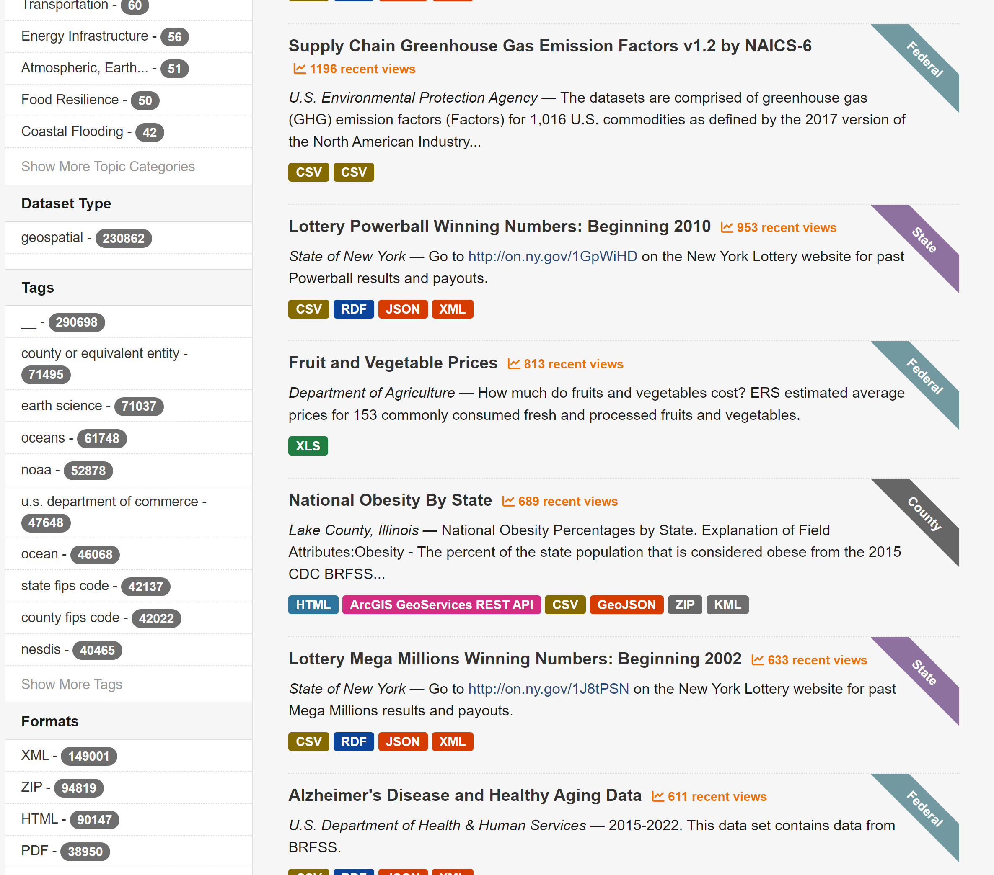
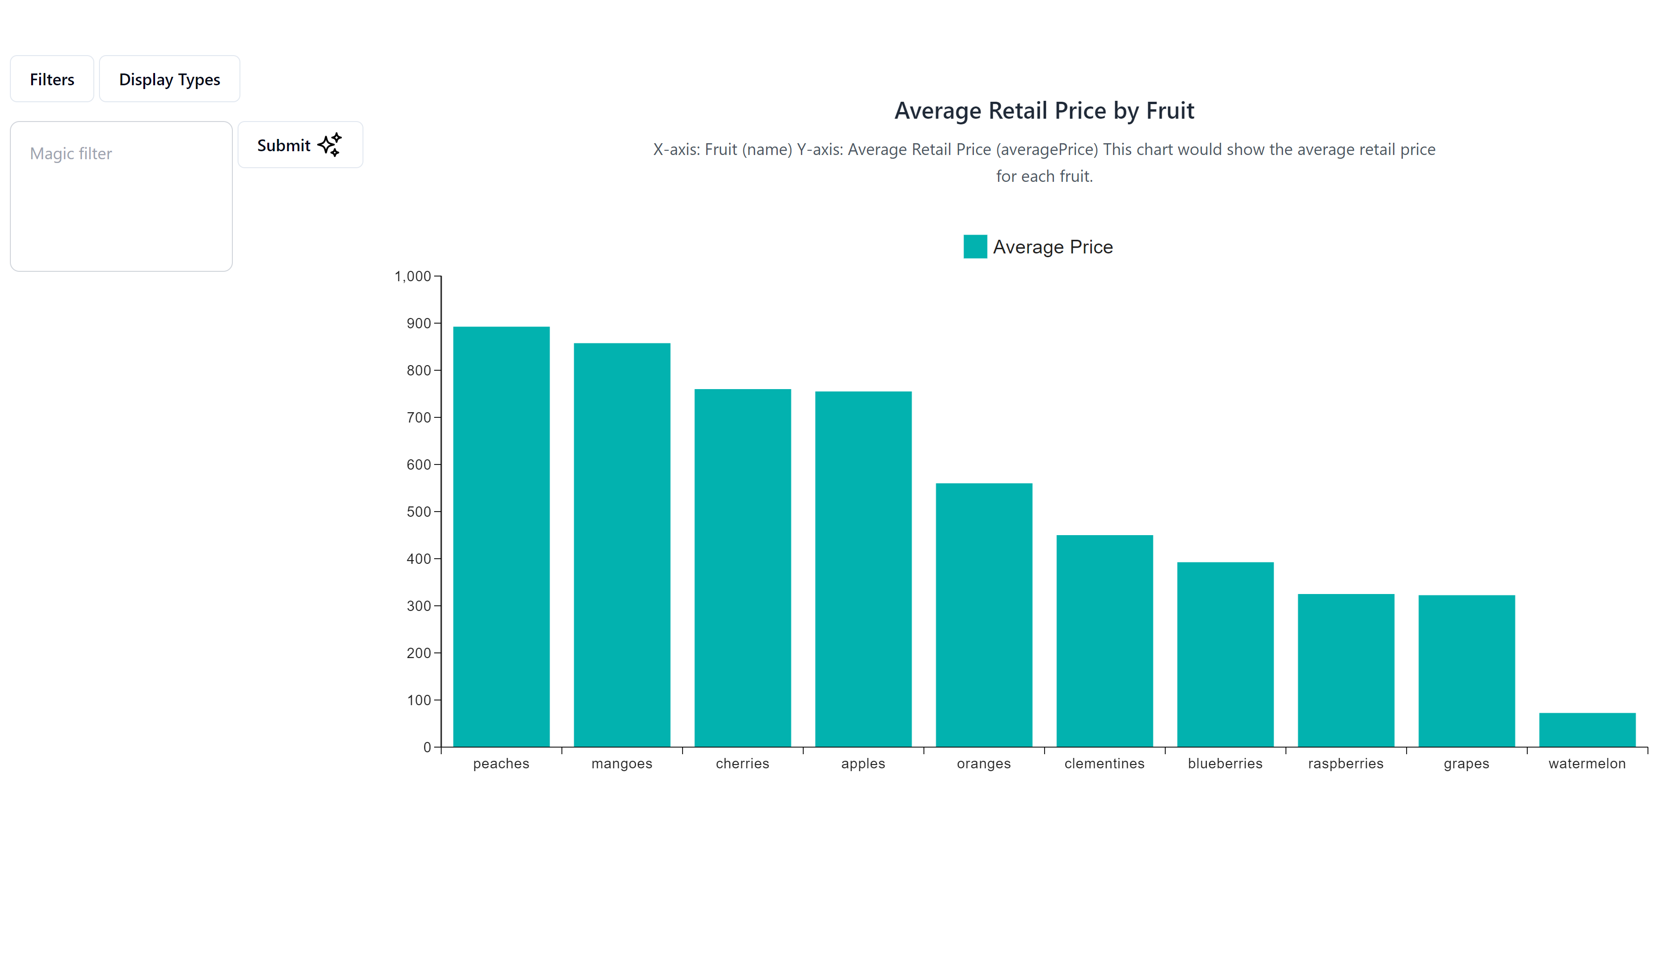
Team 2
Data.gov
Benefits:
Enhance Data Retrieval
Human Accessibility
Data Ready to Consume
AI Benefits:
AI-generated UI designs and code
Every end user interacts with an interface built just for them and their needs in that moment.(Mooran, 2025)
Source: Generative UI and Outcome-Oriented Design (nngroup.com)

